Slide 1
Week 1
The Basics, and beyond!

Slide 2

Who needs this information?

Slide 3
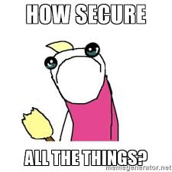
Why are we here?

Slide 4
Corporate vs Personal Security
The Basics
Corporate
Company Security teams
Larger target
More weaknesses
Personal
How to not get hacked (a.k.a don’t be pwned)

Slide 5
Activity!
https://haveibeenpwned.com/

Slide 6
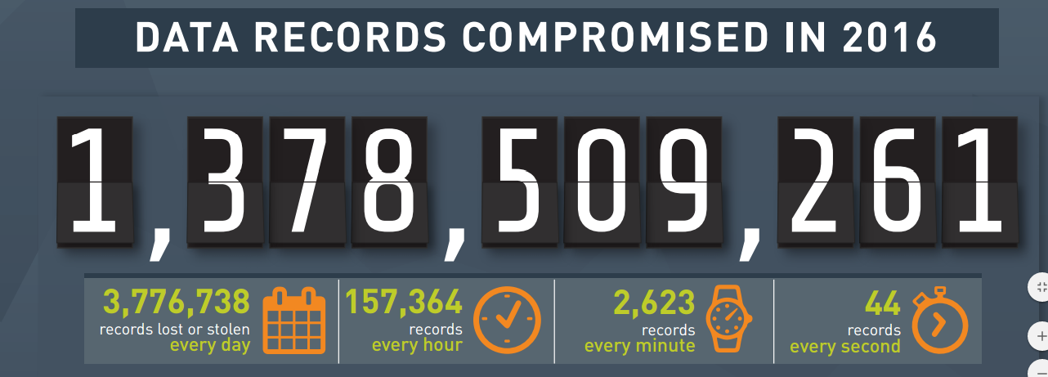
Am I alone in the pwnage?
http://www.informationisbeautiful.net/visualizations/worlds-biggest-data-breaches-hacks/
https://blog.gemalto.com/security/2017/03/29/2016-data-breach-trends-hackers-mine-large-databases-personal-gain/

Slide 7
But, Why did the Pwn happen?
Your password probably sucks
Hey! It doesn’t suck, I use the same awesome password everywhere ← NO
Hey! It doesn’t suck, QWERTY is sooo easy to remember ← NO
Hey! My dog/mother/friends name is an awesome password ← NO
You don’t have/use two factor authentication
You tell the truth on the security questions when you register for sites

Slide 8

Am sad over pwnage, how fix?
https://krebsonsecurity.com/password-dos-and-donts/
https://www.wired.com/2016/05/password-tips-experts/
https://www.askideas.com/31-most-funny-sad-pictures-and-photos/

Slide 9
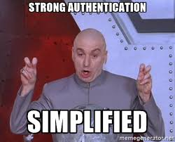
Authentication
Factors
Know
Have
Are
Two-Factor

Slide 10
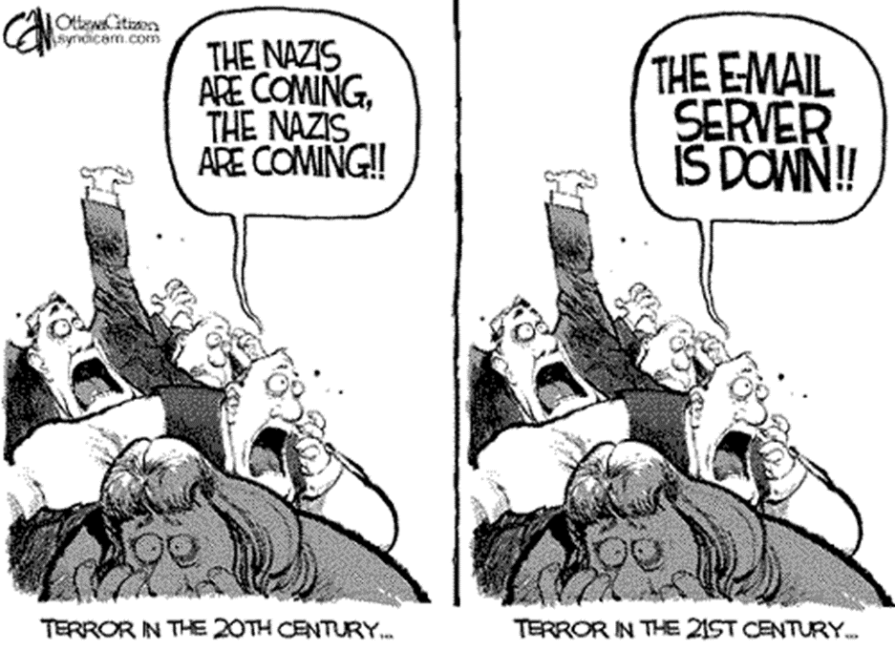
Email Server is down

Slide 11
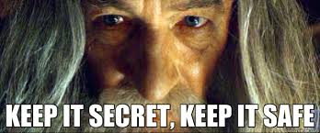
Confidentiality

Slide 12
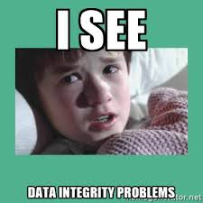
Integrity

Slide 13
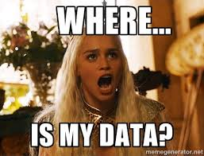
Availability

Slide 14
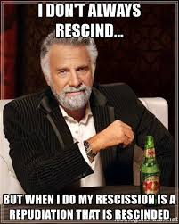
Repudiation

Slide 15
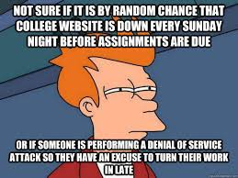
Denial Of Service
DOS
DDOS
DDOS vs Viral
Current Examples
Dyn
Mirai

Slide 16
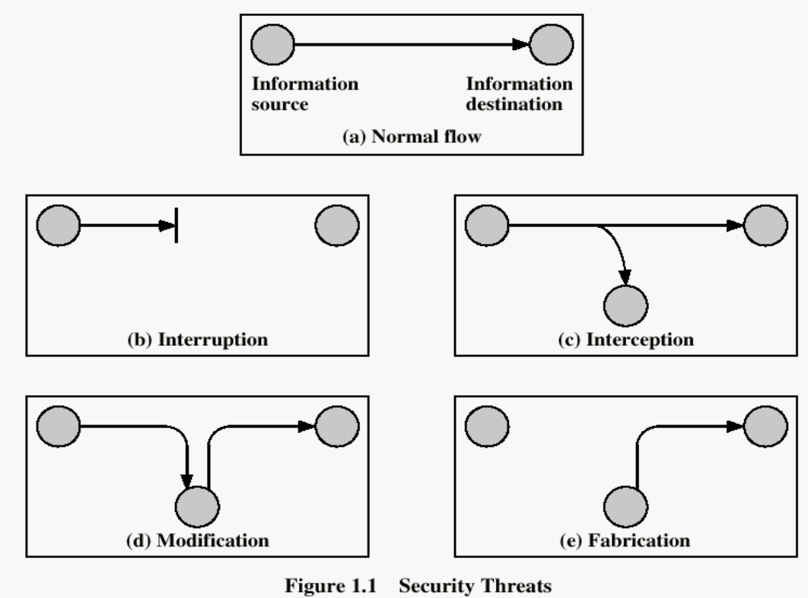
Communication Attack

Slide 17
Policy vs Mechanism
Security Policy
What is and is not allowed
Only the admin shall change passwords
Security mechanism
How to enforce the policy
Password file is encrypted and authenticates admin, keeps a log of all retrieval attempts.

Slide 18
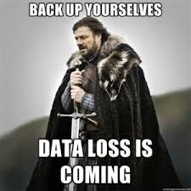
Mechanisms
Prevention
Detection
Recovery
IDS
IPS

Slide 19
Example
Prevention
Locks and bars on house
Detection
Stolen items are…..stolen
Recovery
Call police, make insurance claim and replace items

Slide 20
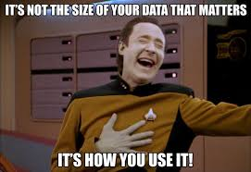
Data Handling
Data type
Media type
Responsibility (Who’s fault is it?)
Breaking data into pieces
How long to keep it
Backups
Need all the same questions answered
Electronic vs IRL data
Data integrity

Slide 21
PII in Massachusettes
Personal information - a combination of a name along with a Social Security number, bank account number, or credit card number
Encrypted when stored on portable devices, or transmitted wirelessly or on public networks.
Regulations call on businesses to utilize up-to-date firewall protection that creates an electronic gatekeeper between the data and the outside world and only permits authorized users to access or transmit data, according to preset rules.
http://www.mass.gov/ago/doing-business-in-massachusetts/privacy-and-data-security/standards-for-the-protection-of-personal.html

Slide 22
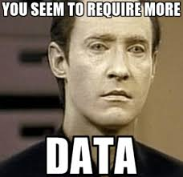
Data set value
Credit cards
Social Security Numbers
Email address
Physical addresses
Social media accounts
Bank Accounts

Slide 23
Example of Value Brazilian Underground
BRAZILIAN UNDERGROUND
Set of business application account credentials US$155–193
Set of credit card credentials US$35–135
Set of online service account credentials US$19
List of mobile phone numbers US$290–1,236
List of landline phone numbers US$317–1,931
https://www.trendmicro.com/vinfo/us/security/special-report/cybercriminal-underground-economy-series/global-black-market-for-stolen-data/

Slide 24
Example of Value
Visa or MasterCard credentials | $7
Credit card with magnetic stripe or chip data | $15
Premium American Express, Discover Card, MasterCard or Visa with strip or chip data | $30
Bank account credentials (balance of $15,000) | $500
Bank account credentials (balance of $70,000 to $150,000) | 6% of account balance
Large U.S. airline points accounts | 1.5 million points cost $450
Large international hotel chain points account | 1 million points cost $200
http://www.bankrate.com/financing/credit-cards/prices-rise-for-your-data-on-the-black-market/

Slide 25
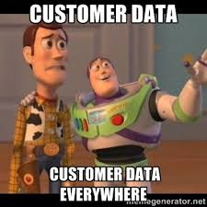
Data set risks
Hackers
Equation Group (NSA)
PEBKAC
Apathy from consumers
Government infrastructure
Equifax
IRS
Georgia secretary of state office
Office of Personnel Management (OPM)
USPS
Insider theft
Edward Snowden Data Leaks

